Slide 1








ASP.NET Web API
Creating Web Services with C#
Web Services & Cloud
SoftUni Team
Technical Trainers
Software University
http://softuni.bg

Slide 2

Table of Contents
What is ASP.NET Web API?
Web API Features
Web API Controllers
Actions
Routes
Return Types and Status Codes
Binding Models and View Models
Built-In User Identity

Slide 3


What is ASP.NET Web API?
Web API

Slide 4

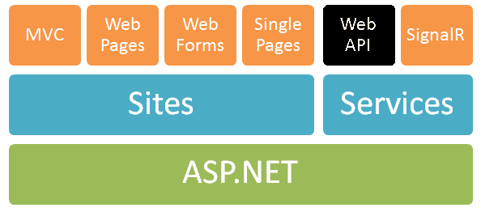
ASP.NET Web API
ASP.NET Web API == platform for building RESTful Web services
Running over the .NET Framework
Using the ASP.NET development stack

Slide 5
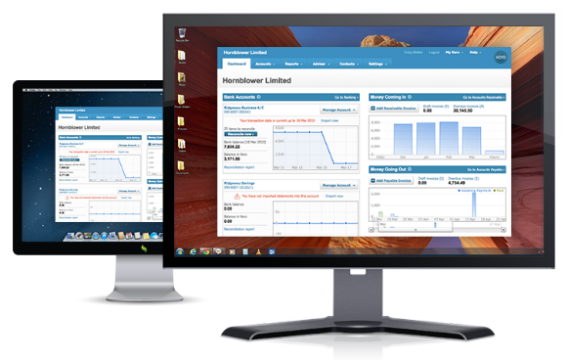


ASP.NET Web API
Data storage
XML
HTTP GET
JSON
Data Layer (EF)
ASP.NET Web API
Models
JSON
XML
HTTP PUT, POST, DELETE

Slide 6
Web API Features
Easy to use framework, very powerful
Modern HTTP programming model
Access to strongly typed HTTP object model
HttpClient API – same programming model
Content negotiation
Client and server negotiate about the right data format
Default support for JSON, XML and Form URL-encoded formats
We can add own formats and change content negotiation strategy

Slide 7
Web API Features (2)
Query composition
Support automatic paging and sorting
Support querying via the OData URL conventions when we return IQueryable<T>
Model binding and validation
Combine HTTP data in POCO models
Data validation via attributes
Supports the same model binding and validation infrastructure as ASP.NET MVC

Slide 8
Web API Features (3)
Routes (mapping between URIs and code)
Full set of routing capabilities supported within ASP.NET (MVC)
Filters
Easily decorates Web API with additional validation
Authorization, CORS, etc.
Testability
IoC and dependency injection support
Flexible hosting (IIS, Azure, self-hosting)

Slide 9
ASP.NET Web API 2
Attribute routing
OData improvements: $select, $expand, $batch, $value and improved extensibility
Request batching
Portable ASP.NET Web API Client
Improved testability
CORS (Cross-origin resource sharing)
Authentication filters
OWIN support and integration (owin.org)

Slide 10
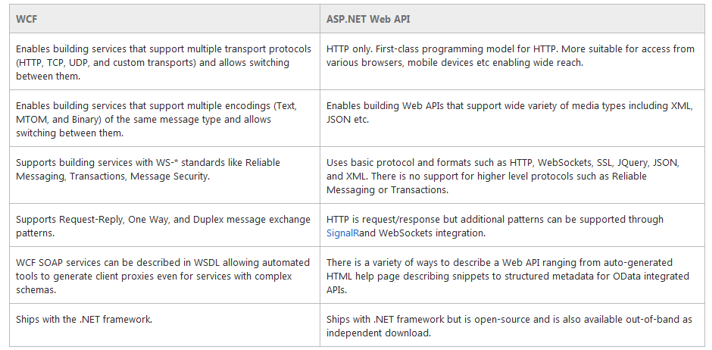
WCF vs. ASP.NET Web API
WCF is also a good framework for building Web services

Slide 11
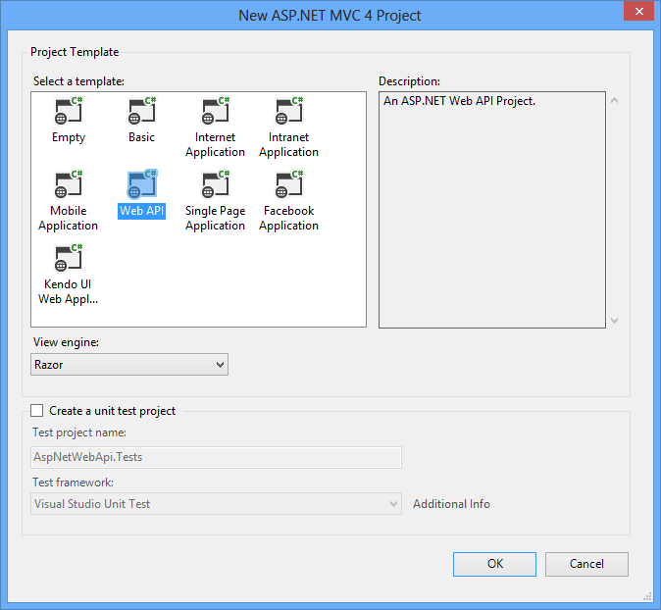
Creating ASP.NET Web API Project
Default ASP.NET Web API Project Template

Slide 12


Web API Controllers

Slide 13
Web API Controllers
A controller class handles HTTP requests
Web API controllers derive from ApiController
ASP.NET Web API by default maps HTTP requests to specific methods called "actions"
Action | HTTP method | Relative URI | Method
Get a list of all posts | GET | /api/posts | Get()
Get a post by ID | GET | /api/posts/id | Get(int id)
Create a new post | POST | /api/posts | Post(PostModel value)
Update a post | PUT | /api/posts/id | Put(int id, PostModel value)
Delete a post | DELETE | /api/posts/id | Delete(int id)
Get a post by category | GET | /api/posts?category=news | Get(string category)

Slide 14
Actions
Actions are public methods of a controller
public class PostsController : ApiController
{
[HttpGet]
public IEnumerable<string> GetPosts()
{
return new [] { "Hello", "WS&C deadline question.." };
}
[HttpPost]
public void AddPost(string content)
{
// Add post to DB..
}
}

Slide 15
Web API Request Processing
Web request is sent
Match controller from route
Controller Responds
public class PostsController : ApiController
{
public string Get()
{
return "Some data"; }
public string Edit(Post post)
{
...
}
}
public class UsersController : ApiController
{
...
}
http://localhost:1337/api/posts
GET /api/posts HTTP/1.1
Host: localhost:1337
Cache-Control: no-cache
HTTP/1.1 200 OK
Content-Length: 11
"some data"

Slide 16
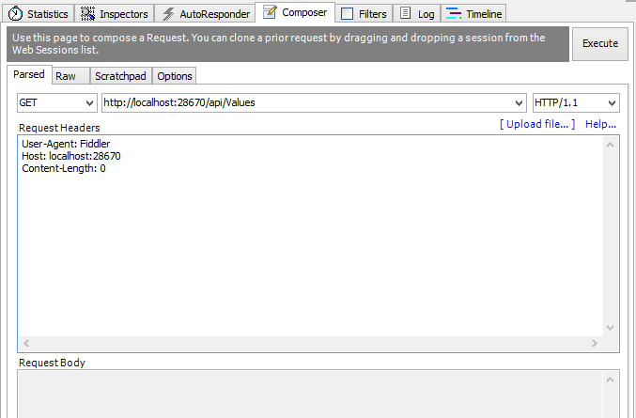

Creating API Controller
Live Demo

Slide 17

Routing
Routing == matching URI to a controller + action
Web API support the full set of routing capabilities from ASP.NET (MVC)
Route parameters
Constraints (using regular expressions)
Extensible with own conventions
Attribute routing is available in version 2
api/users
api/posts/id
api/comments

Slide 18
Attribute Routing
Routing can be done through attributes
[RoutePrefix()] – annotates a controller route
[Route()] – annotates a route to an action
[HttpGet],[HttpPut], [HttpPost], etc. – specify the request method
[RoutePrefix("api/posts")]
public class PostsController : ApiController
{
[Route("{id}")]
public Post Get(int id)
{ ... }
[HttpGet]
[Route("{id}/likes")]
public IEnumerable<Like> GetPostLikes(int id)
{ ... }
}

Slide 19
Default Route
Web API also provides smart conventions by default
HTTP Verb is mapped to an action name
Configurations can be added in WebApiConfig.cs
config.Routes.MapHtpRoute(
name: "DefaultApi",
routeTemplate: "api/{controller}/{id}",
defaults: new { id = RoutesParameter.Optional }
);

Slide 20
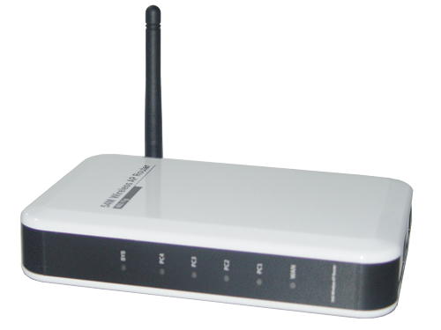
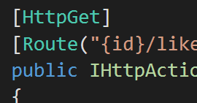
Configuring Routes
PostsController
GET /api/posts HTTP/1.1
Host: localhost:1337
Cache-Control: no-cache
UsersController
CommentsController
Live Demo

Slide 21

Return Types
IQueryable<T>
IHttpActionResult
T, IEnumerable<T>, IQuearyable<T> IHttpActionResult

Slide 22
Return Types
Actions can return several types
Returned data automatically serialized to JSON or XML
T – generic type (can be anything)
IEnumerable<T> - foreach-able collection of generic type T
IQueryable<T> - collection of generic type T (supports filtering, sorting, paging, etc.)
public Comment GetCommentById(int id) { ... }
public IEnumerable<Comment> GetPostComments(int id) { ... }
public IQueryable<Comment> GetPostComments(int id) { ... }

Slide 23
Return Types (2)
void – returns empty HTTP response 204 (No Content)
IHttpActionResult – returns an abstract HTTP response with status code + data
public IHttpActionResult GetPostComments(int id)
{
var context = new ForumContext();
var post = context.Posts.FirstOrDefault(p => p.Id == id);
if (post == null)
return this.BadRequest("Invalid post id");
return this.Ok(post);
}
200 OK + serialized data

Slide 24
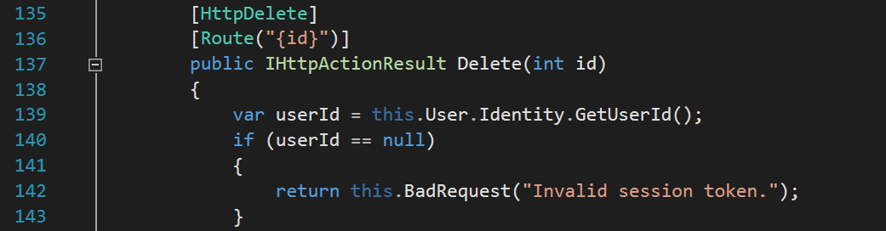
Return Types
Live Demo

Slide 25
HTTP Status Codes
It's a good practice always to return a status code
Return data with concrete status code method (e.g. Ok(), BadRequest(), NotFound(), Unauthorized(), etc.)
Return only status code
var top10Users = context.Users.All()
.Take(10)
.Select(u => u.Username);
return this.Ok(top10Users);
return this.StatusCode(HttpStatusCode.Forbidden);

Slide 26
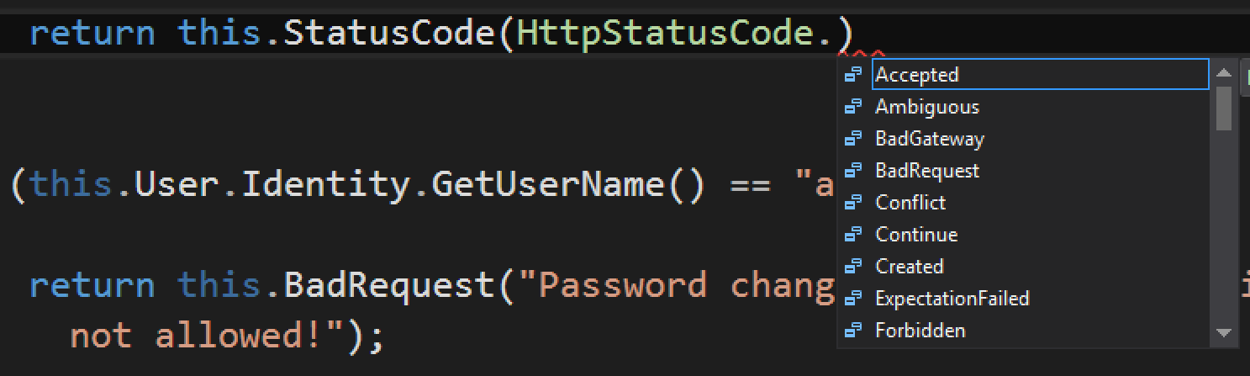
Returning Status Codes
Live Demo

Slide 27
Model Binding
By default the Web API will bind incoming data to POCO (CLR)
Will look in body, header and query string
Request data will be transferred to a C# object
E.g. the query string will be parsed to RegisterBindingModel
.../api/users/register?username=donjuan&password=12345
public IHttpActionResult Register(
RegisterBindingModel user)
{
string name = user.Username;
...
}
username | donjuan
password | 12345

Slide 28
Binding Models
Request Method:POST
FormData content=Hello+Guys&
author=Gosho&categoryId=5
public class AddPostBindingModel
{
public string Content { get; set; }
public int AuthorId { get; set; }
public int? Category { get; set; }
}
Validation attributes can be set in the binding model
[HttpPost]
public IHttpActionResult CreatePost(AddPostBindingModel postModel)
{
if (!postModel.Category.HasValue) ...
}

Slide 29
Binding Model Validation
ModelState holds information about the binding model
Request Method:POST
FormData username=Motikarq&password=#otpo6ti4kata
public class UsersController : ApiController
{
public IHttpActionResult Register(RegisterBindingModel user)
{
if (!this.ModelState.IsValid)
return this.BadRequest(this.ModelState);
...
}
}
public class RegisterBindingModel
{
[Required]
public string Username { get; set; }
[MinLength(6)]
public string Password { get; set; }
public int Age { get; set; }
}

Slide 30
Using Binding Models – Example
public IHttpActionResult AddPost(AddPostBindingModel postModel)
{
if (!this.ModelState.IsValid)
return this.BadRequest(this.ModelState);
var context = new ForumContext();
var author = context.Users
.FirstOrDefault(u => u.Username == postModel.Author);
if (author == null)
return this.BadRequest("Author does not exist");
context.Posts.Add(new Post() { Content = postModel.PostContent, Author = author, CategoryId = postModel.CategoryId });
context.SaveChanges();
return this.Ok(newPost);
}

Slide 31
Data Source Attributes
Web API can specify request data source
[FromUri] – binds data from query string to action parameters
[FromBody] – binds data from request body to binding model
http://localhost:1337/api/posts/comments?page=5
public IHttpActionResult GetComments([FromUri]int page)
{...}
public IHttpActionResult Register(
[FromBody]RegisterBindingModel user)
{ ... }

Slide 32
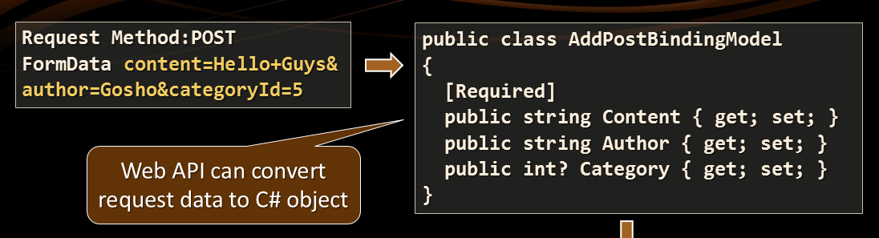
Model Binding
username=DonJuan&password=12345...
Live Demo

Slide 33
Media Type Formatters
MediaTypeFormatters are used to bind both input and output
Mapped to content types
In WebApiConfig.cs we can configure the response to return JSON by default
And JSON to follow camel case conventions
config.Formatters.JsonFormatter.SupportedMediaTypes.Add(
new MediaTypeHeaderValue("text/html"));
config.Formatters.JsonFormatter.SerializerSettings.ContractResolver =
new CamelCasePropertyNamesContractResolver();

Slide 34
View Models
View models are classes which represent data to be displayed
Used to project only needed data
[HttpGet]
public IHttpActionResult GetAllComments(int postId)
{
var post = this.context.Posts.FirstOrdDefault(p => p.id == postId);
if (post == null)
return this.BadRequest("Invalid post id");
var comments = post.Comments.Select(c => new CommentViewModel
{
Id = c.id
Content = c.Content,
});
return this.Ok(comments);
}
public class CommentViewModel
{
public int Id { get; set; }
public string Content { get; set; }
}

Slide 35


View Models
Live Demo

Slide 36

OData
OData (http://odata.org) is a open specification written by Microsoft
Provides a standard query syntax on resources, e.g.:
ASP.NET Web API includes automatic support for this syntax
Return IQueryable<T> instead of IEnumerable<T>, e.g.:
OData
http://localhost/api/posts?$skip=10&$take=10
public IQueryable<Comment> GetPostComments(int id) { ... }

Slide 37
OData Query Installation
To enable OData queries
Install the Microsoft.AspNet.OData package from NuGet
Action return type should be IQueryable<T>
Set the [EnableQuery] attribute above the action
Then we can make OData queries like:
http://localhost/api/posts?$filter=Likes gt 5&$orderby=Date&$top=3
Selects posts with likes greater than 5
Takes first 3
Orders by date

Slide 38
OData Keywords
See full Odata URI conventions
Option | Description
$filter | Filters the results, based on a Boolean condition
$inlinecount | Tells the server to include the total count of matching entities in the response.
$orderby | Sorts the results.
$skip | Skips the first n results.
$top | Returns only the first n the results.

Slide 39
Using OData – Example
public class PostsController : BaseApiController
{
[EnableQuery]
public IQueryable<PostViewModel> GetAll()
{
var context = new ForumContext();
return ForumContext.Posts
.Select(p => new PostViewModel
{
Id = p.Id,
Content = p.Content,
Date = p.Date,
Likes = p.Likes.Count()
});
}
}
public class PostViewModel
{
public int Id { get; set; }
public string Content { get; set; }
public DateTime Date { get; set; }
public int Likes { get; set; }
}

Slide 40


OData with Web API
OData
Live Demo

Slide 41
CORS
Cross-Origin Resource Sharing allows cross domain requests
E.g. www.softuni.bg makes AJAX request to www.nakov.com/api
Disabled by default for security reasons, can be enabled in Startup.Auth.cs
Requires Microsoft.Owin.Cors middleware package installed
app.UseCors(Microsoft.Owin.Cors.CorsOptions.AllowAll);

Slide 42



ASP.NET Identity API
Setup, Registration, Login, Logout

Slide 43
ASP.NET Identity
The ASP.NET Identity system
Authentication and authorization system for ASP.NET Web apps
Supports ASP.NET MVC, Web API, Web Forms, SignalR, Web Pages
Handles users, user profiles, login / logout, roles, etc.
Based on the OWIN middleware (can run outside of IIS)
Automatically integrated when the Individual User Accounts option is selected on Web API project creation

Slide 44


Identity Authentication (Login)
POST localhost:55602/Token
Username | motikarq@gmail.com
Password | 1234567
grant_type | password
localhost:55602
200 OK
access_token | 22k_HP6fSFwsQ88L3_JQh9nnx3…
token_type | bearer
expires_in | 1209599
userName | jamal@hussein.com
.expires | Thu, 27 Aug 2015 12:42:38 GMT
Sent in future requests' headers for authentication

Slide 45
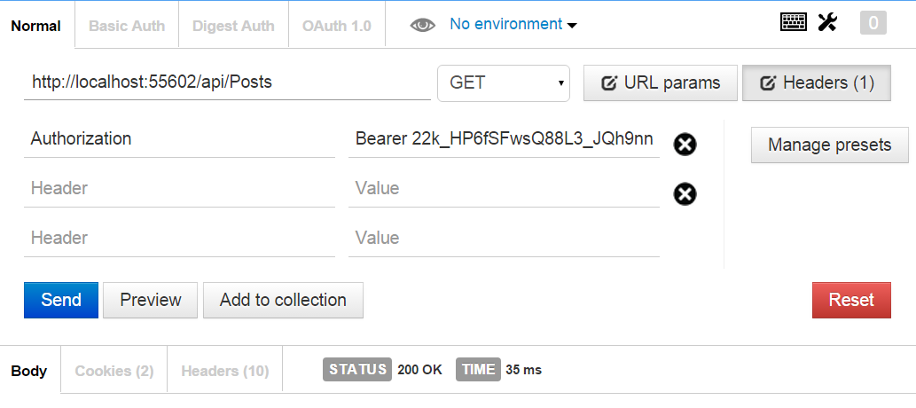
Request Authentication
Access token should be put in request headers

Slide 46
ASP.NET Authorization
Use the [Authorize] and [AllowAnonymous] attributes to configure authorized / anonymous access for controller / action
[Authorize]
public class AccountController : ApiController
{
// GET: /account/login (annonymous)
[AllowAnonymous]
public IHttpActionResult Login(LoginBindingModel model) { … }
// POST: /account/logout (for logged-in users only)
[HttpPost]
public IHttpActionResult Logout() { … }
}

Slide 47
Check the Currently Logged-In User
// GET: /users/gosho (for logged-in users only)
[Authorize]
public IHttpActionResult GetUserInfo()
{
string currentUserId = this.User.Identity.GetUserId();
if (currentUserId == null)
{
return this.Unauthorized("Access denied");
}
...
}

Slide 48



ASP.NET Identity
Live Demo

Slide 49









ASP.NET Web API
https://softuni.bg/courses/web-services-and-cloud/

Slide 50
License
This course (slides, examples, demos, videos, homework, etc.) is licensed under the "Creative Commons Attribution-NonCommercial-ShareAlike 4.0 International" license
Attribution: this work may contain portions from
"Web Services and Cloud" course by Telerik Academy under CC-BY-NC-SA license

Slide 51






Free Trainings @ Software University
Software University Foundation – softuni.org
Software University – High-Quality Education, Profession and Job for Software Developers
softuni.bg
Software University @ Facebook
facebook.com/SoftwareUniversity
Software University @ YouTube
youtube.com/SoftwareUniversity
Software University Forums – forum.softuni.bg

